Slide 1

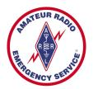
Training Volunteers
The ARRL
Introduction to Emergency Communication Course
EC-001 (2011)
Session Three
Notes:
Make sure you have modified the Name and Date.
Display this screen as students are arriving for class.

Slide 2
Reminder
Complete two DHS/FEMA Courses
IS-100.b Introduction to ICS
IS-700 National Incident Management System
Http://training.fema.gov/IS/NIMS.asp
Notes:
ARRL conditions!
The two ICS courses must be complete before taking the final exam.

Slide 3
Session Three Topic
Session 1 – Topics 1, 2, 3, 4, 5a, 5b
Session 2 – Topics 6, 7a, 7b, 7c, 7d, 8, 9, 10
Session 3 – Topics 11, 12, 13, 14, 15
Session 4 – Topics 16, 17, 18, 19, 20
Session 5 – Topics 21, 22, 23, 24, 25, 26, 27
Session 6 – Topics 28, 29, Summary, Final Exam
Notes:
The course requires a total of 18 hours.
If a student misses one class they can take a practice quiz for each lesson missed.
A student missing two sessions will be asked to take the course again.
A student missing the last session must wait for the next class and attend the final session for taking the exam again.
An exception would be two Field Examiners agreeing to give the exam at a mutually scheduled time.

Slide 4
Topic 14 – Basic Message Handling Part 1

Slide 5
Consider the following scenario: The “Request”
There are 330 hurricane evacuees in a Red Cross shelter. ARES is providing communications, working in 12-hour shifts. An elderly diabetic woman is brought in at 1400 hours.
She will require her next dose of insulin by 2300 hours. The manager goes to the radio room. There is an operator wearing a red baseball hat with funny numbers and letters on it.
He asks the operator to inform the county EOC of the medication need. The operator calls the Red Cross EOC and says, "Hey, we have a diabetic lady here who will need insulin by 2300 hours," but doesn't write the message down or log the request.

Slide 6
Consider the following scenario: The “Fumble”
At 2030 hours the medication has still not been delivered. The shelter manager goes to the radio room to inquire about its status. There is now a different person with a blue baseball cap with a new set of funny letters and numbers.
He knows nothing of the earlier request, but promises to "check on it." In the meantime, EOC personnel have discarded the message because it was written on a scrap of paper and had no signature authorizing the order for medication. No one sent a return message requesting
authorization.

Slide 7
Consider the following scenario: The “Hot Wash”
If each operator had generated and properly logged a formal message, with an authorized signature, it would be a relatively simple matter to track.
The informal message has no tracks to follow. Also, by sending a formal message, you are nearly guaranteeing that the receiving station will write it down properly (with a signature) and log it, greatly enhancing its chances of being delivered intact.

Slide 8
The Big Question
In Emcomm or Public Service Communications
are most messages
Formal or Informal or Tactical ?

Slide 9
Types of Traffic
Formal message traffic
Fault-intolerant information
Requires authentication or signoff
Passes through several 'hands'
Requires a formal paper trail

Slide 10
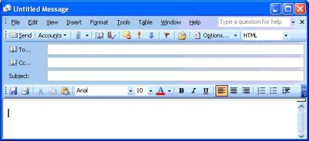
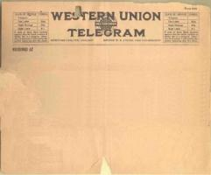
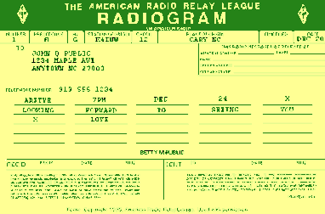
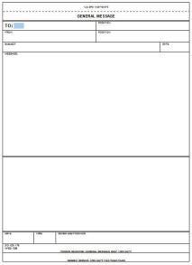
Formal Traffic

Slide 11
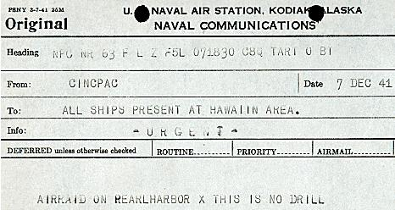
Famous Formal Message

Slide 12
Types of Traffic
Informal message traffic
Does not require formal authentication
Logged by sending and receiving stations
Does not require the use of message forms or structured handling procedures

Slide 13

Informal Traffic

Slide 14
Types of Traffic
Tactical message traffic
Goes directly from originator to recipient
Does not require a paper trail
Does not require formal authentication
Must be delivered in a timely manner.

Slide 15
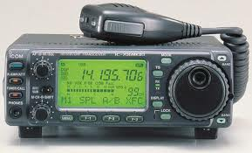

Tactical Message Traffic

Slide 16
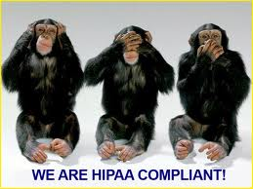
How Does HIPAA Impact You? (The Health Insurance Portability and Accountability Act)
Overheard conversations
Overseen patient treatment
Overseen medical records
Inappropriate requests to transmit PHI over the radio
If your agency insists, have an official sign the log book indicating they demanded it!
Failure to Comply Can Result in Civil &
Federal Criminal Penalties

Slide 17
Formal Message Handling

Slide 18
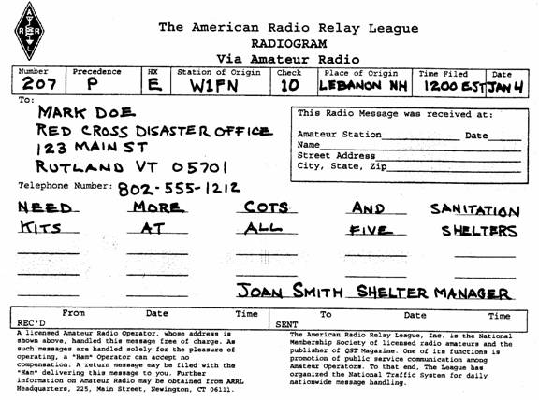
Formal Written Message Formats
Preamble
Address
Text
Signature
Receiving station
Notes:
A standard written message format is used so that everyone knows what to expect. This increases the speed and accuracy with which you can handle messages.
The ARRL message form, or "Radiogram," is a standard format used for passing messages on various nets, and is required for all messages sent through the National Traffic System. While this format may not be perfect for all applications, it serves as a baseline that can be readily adapted for use within a specific served agency. Regular practice with creating and sending messages in any standard format is recommended.

Slide 19
Details of the Preamble
❶
❷
❸
❹
❺
❻
❼
❽
❺
PR
❷
Routine – Welfare – Priority - “Emergency”
❸
7 Standard A to G (HXE = Delivering station to get and send reply from addressee)
Special note: Punctuation is rarely used in the text field
Notes:
A standard written message format is used so that everyone knows what to expect. This increases the speed and accuracy with which you can handle messages.
The ARRL message form, or "Radiogram," is a standard format used for passing messages on various nets, and is required for all messages sent through the National Traffic System. While this format may not be perfect for all applications, it serves as a baseline that can be readily adapted for use within a specific served agency. Regular practice with creating and sending messages in any standard format is recommended.

Slide 20
Pro-Words
Voice and CW
Too many to list here
Examples:
“Break” BT
“End” AR
“Figures”
“I Spell”
“Go Ahead” K
“Roger” R

Slide 21
Sending a Message with Voice
Pace
“say again all after _____”
“say again all before _____”
“say again all between _____ and _____”
Use “break” between sections
“three two one five zero”

Slide 22
Time Savers
No need to say the block name
Here is an example:
“Number two zero seven precedence, Priority handling instructions, HX Echo station of origin W1FN check one zero place of origin, Lebanon NH time one two zero EST, January 4. Going to Mark Doe, Red Cross Disaster Office Address figures one two three Main Street Rutland VT, Zip figures zero five seven zero one. Telephone Figures eight zero two five five five one two one two.”
65 spoken words

Slide 23
Time Savers
No need to say the block name
Here is an example:
“Number two zero seven precedence, Priority handling instructions, HX Echo station of origin W1FN check one zero place or origin, Lebanon NH time one two zero EST, January 4. Going to Mark Doe, Red Cross Disaster Office Address figures one two three Main Street Rutland VT, Zip figures zero five seven zero one. Telephone Figures eight zero two five five five one two one two.”
48 spoken words

Slide 24
Summary
Any questions before the quiz?

Slide 25
Time for a Quiz
Take 30 Seconds adjust your workspace

Slide 26
30
Seconds

Slide 27
20
Seconds

Slide 28
10
Seconds

Slide 29
9
Seconds

Slide 30
8
Seconds

Slide 31
7
Seconds

Slide 32
6
Seconds

Slide 33
5
Seconds

Slide 34
4
Seconds

Slide 35
3
Seconds

Slide 36
2
Seconds

Slide 37
1
Seconds

Slide 38
Let's get started!

Slide 39
Topic 14 Question
The preamble to an ARRL Radiogram message contains a block called "Precedence". Which of the following represents the correct precedence for an EMERGENCY message?
"URGENT"
"U"
"EMERGENCY"
"E"

Slide 40
Topic 14 Question
The preamble to an ARRL Radiogram message contains a block called "Handling Instructions." What is the meaning of the handling instruction "HXE"?
Delivering station to get and send reply from addressee
Report date and time of delivery to originating station
Cancel message if not delivered within (X) hours of filing time
Collect telephone delivery authorized

Slide 41
Topic 14 Question
ARRL Radiogram messages contains a block called "Time Filed". Which of the following is true of entries in that block?
This field is always completed
Time entries are always Universal Coordinated Time
During emergencies "local time" is used
During emergencies "local time" along with the local date is used

Slide 42
Topic 14 Question
ARRL Radiogram messages contains a block called "The Check." Which of the following is true of entries in that block?
The check contains a count of the words in the entire message
The check contains a count of the words in the preamble and the text of the message
The check contains a count of the words in the preamble, address and text of the message
The check contains a count of the words in the text of the message

Slide 43
Topic 14 Question
Which of the following statements is true of punctuation within an ARRL Radiogram?
Punctuation is always helpful; it should be used whenever possible
Punctuation is rarely helpful; it should never be used
Punctuation should be used only when it is essential to the meaning of the message
The comma and apostrophe are the most common punctuation signs used in NTS messages

Slide 44
Any Questions Before Starting Topic 15?

